Slide 1

Trombone Lesson
By Lloyd P. Silikovitz
“Trombone: Producing Sound,” Amro Music, Trombone Rentals and Sales | Amro Music, Memphishttps://www.amromusic.com/trombone

Slide 2
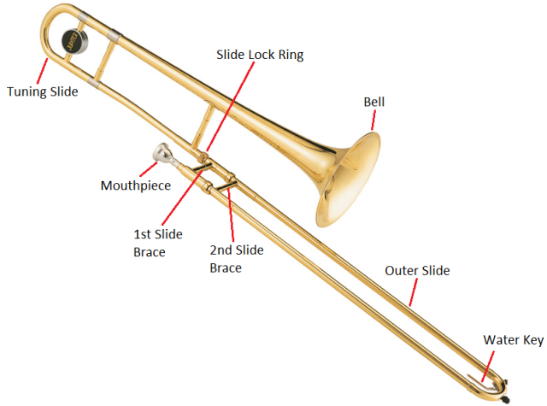
1. Trombone Parts
“Trombone,” Brass Basics, https://brassbasics.wordpress.com/trombone/

Slide 3
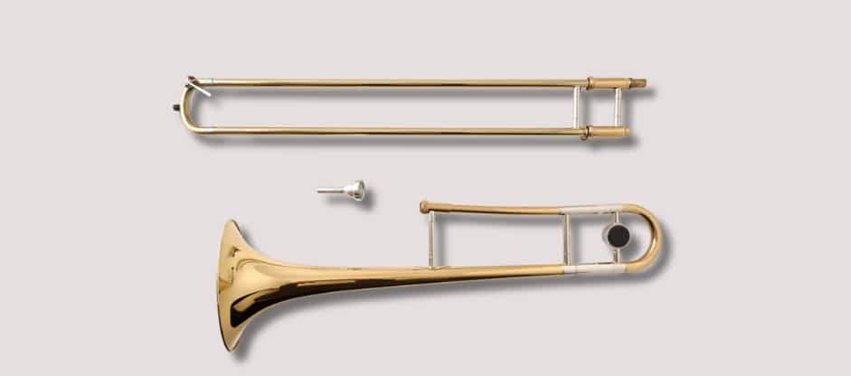
2. Assembling the trombone
Cartmell, Rory. “How to Put a Trombone Together,” https://teds-list.com/tutorial/how-to-put-a-trombone-together/

Slide 4
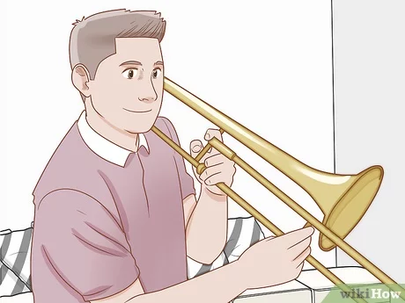
3. Holding the trombone correctly
“How to Hold a Trombone,” Wikihow https://www.wikihow.com/Hold-a-Trombone

Slide 5
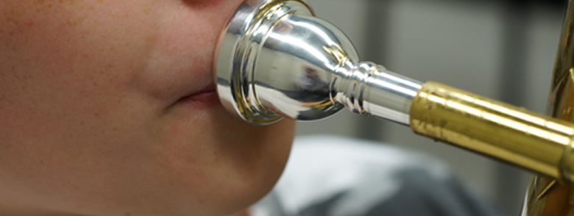
4. Trombone Embouchure
Bewley, Norlan, “The 3 Trombone Mouthpiece Placements,” https://banddirector.com/brass/trombone/the-3-trombone-mouthpiece-placements/

Slide 6
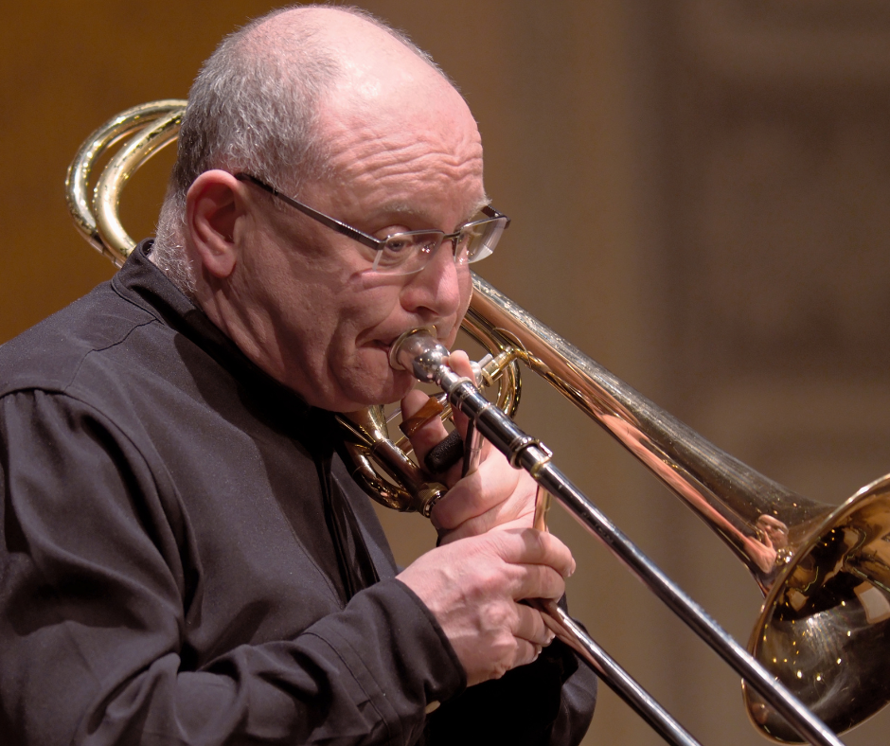
5. Trombone breath support
Houlding, Chris, “Daily Warmup for Advanced Trombone Players,” blog.deniswick https://blog.deniswick.com/daily-warmup-for-advanced-trombone-players

Slide 7
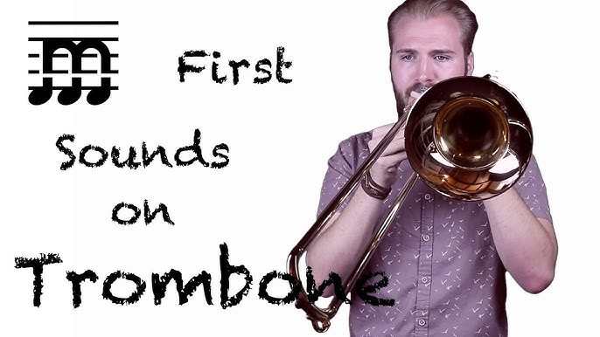
6. Producing the first trombone tone
“Method to the Melody” Youtube https://www.youtube.com/watch?app=desktop&v=wqToj2KLxcQ

Slide 8
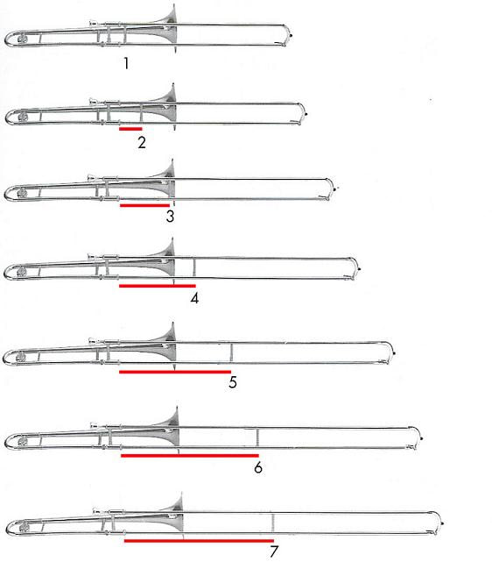
7. First three trombone tones
“Trombone! First Notes,” ettonhome.weebly.comhttps://ettonehome.weebly.com/trombone-first-notes.html

Slide 9


8. Trombone Ear Training
Vining, David, Ear Training For Trombone Carl Fischer.com https://www.carlfischer.com/wf83-ear-training-for-trombone.html

Slide 10
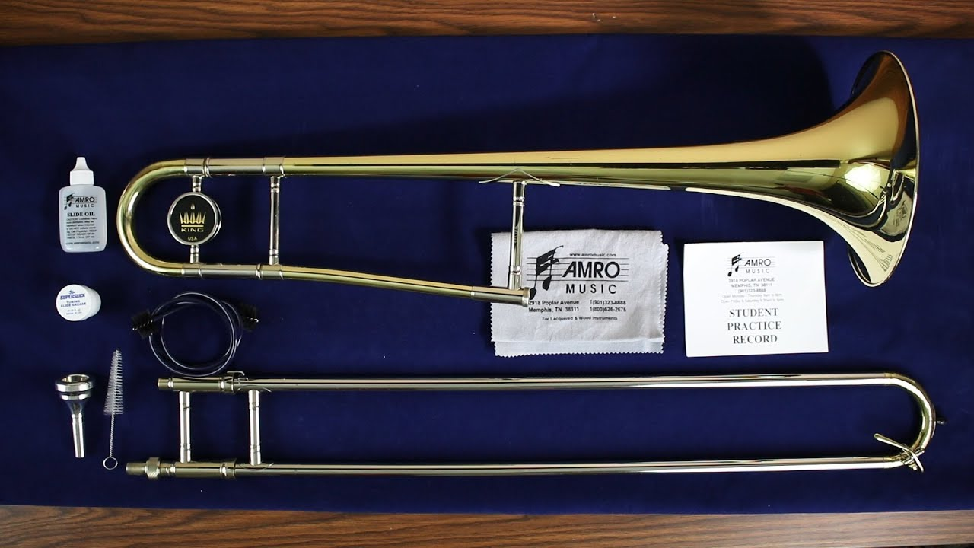
9. Taking care of the trombone
AmroMusic, “How to Clean a Trombone,” Youtube, https://www.youtube.com/watch?app=desktop&v=v478qVPINxY

