Slide 1
Flute Lesson
By Lloyd Silikovitz

Slide 2
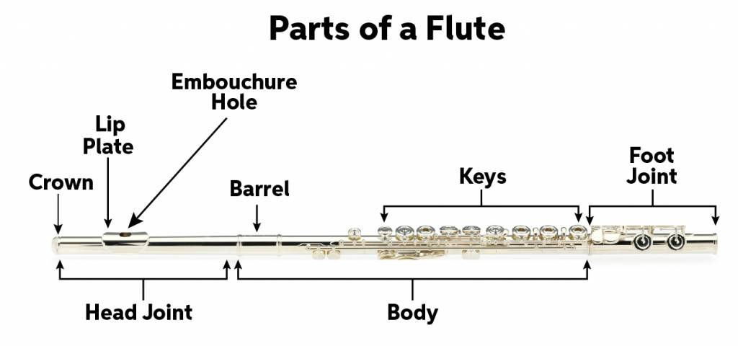
1. Parts of the Flute
“Flute QuickStart Guide.” SweetWater, 11 Mar. 2024. https://www.sweetwater.com/sweetcare/articles/flute-quickstart-guide/

Slide 3
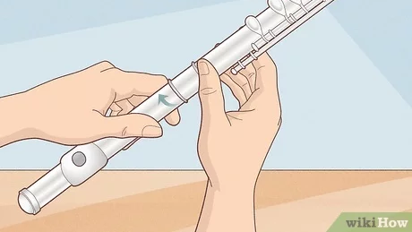
2. Flute Assembly
“How to Assemble a Flute.” Wikihow, 28 Nov. 2024. https://www.wikihow.com/Assemble-a-Flute

Slide 4
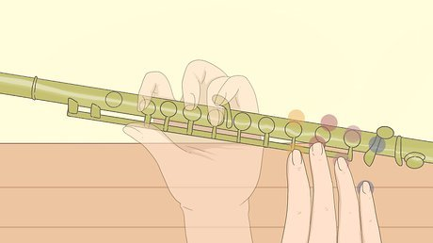
3. Holding the Flute Correctly
“ How to Hold a Flute & Avoid Starting Bad Habits.” Wikihow 2 Nov. 2024 https://www.wikihow.com/Hold-a-Flute

Slide 5
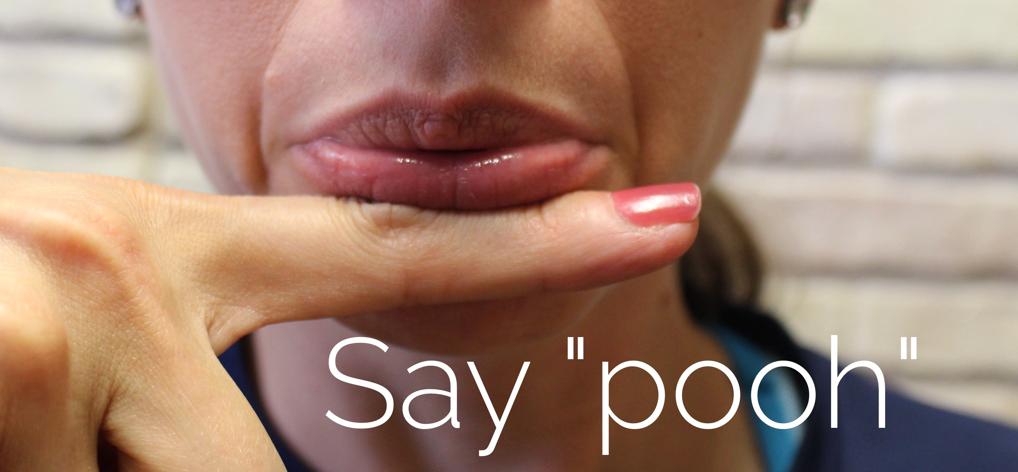
4. Flute Embouchure
“Flute Embouchure: Simple Steps for Great Success.” Band Directors Talk Shop, https://banddirectorstalkshop.com/flute-embouchure/

Slide 6
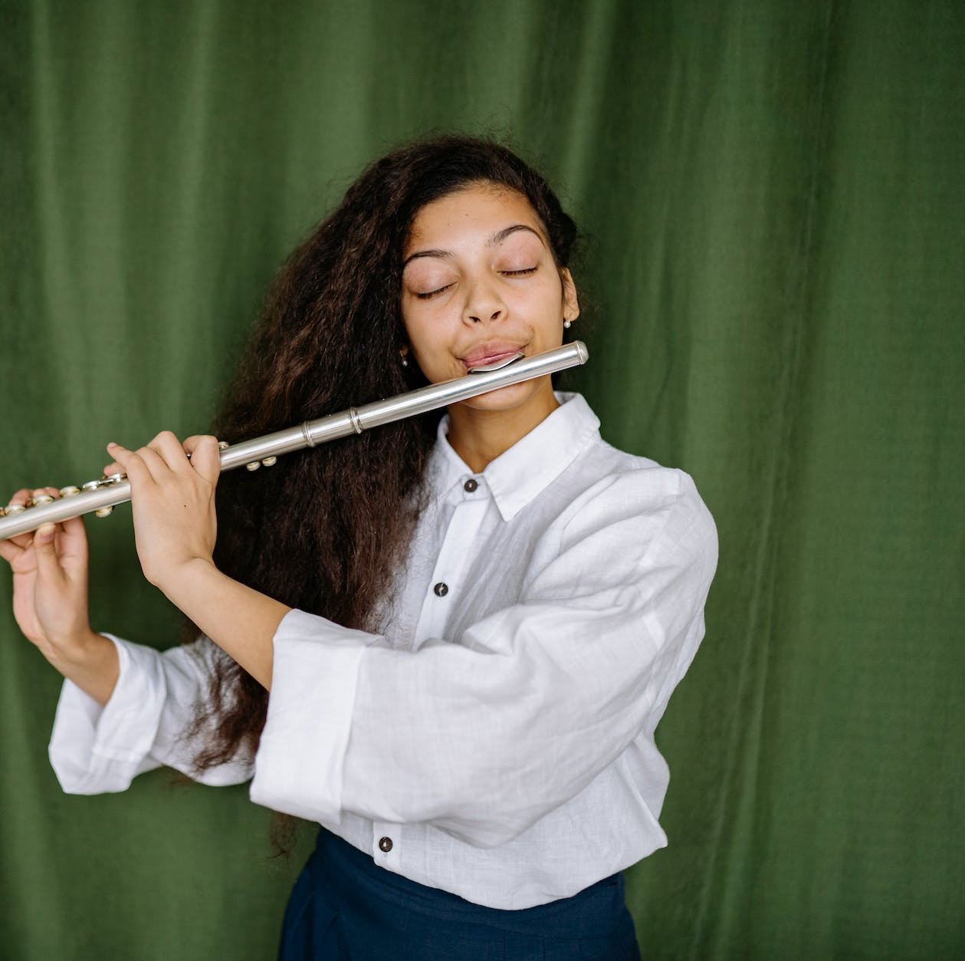
5. Flute Breath Support
Pimentel, Bret “Breath Support.” Bret Pimentel 12 Oct. 2008. https://bretpimentel.com/breath-support/

Slide 7

6. First Flute Tone
“The 3 B Flats.” Hannah B Flute, 12 Mar. 2018 https://hannahbflute.com/2018/03/12/the-3-b-flats-2/

Slide 8
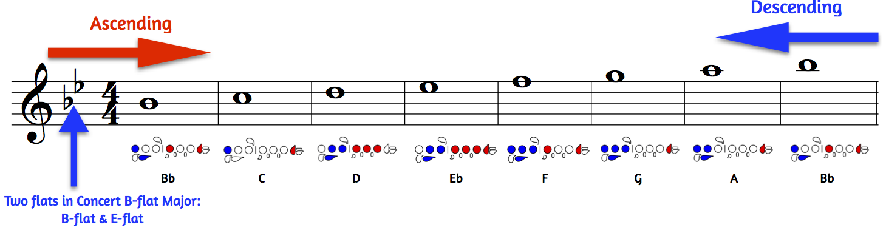
7. First Three Flute Tones
“ Concert B-Flat Major Scale.” Jams Instrumental https://www.jamsinstrumentalmusic.org/flute---concert-bb.html

Slide 9
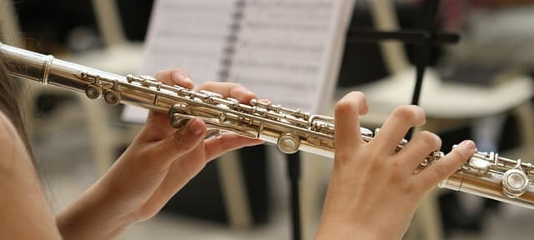
8. Flute Ear Training
“Harmonic Ear Training: Recognize Harmonic Progressions.” Use Your Ear. https://www.useyourear.com/harmonic-ear-training

Slide 10
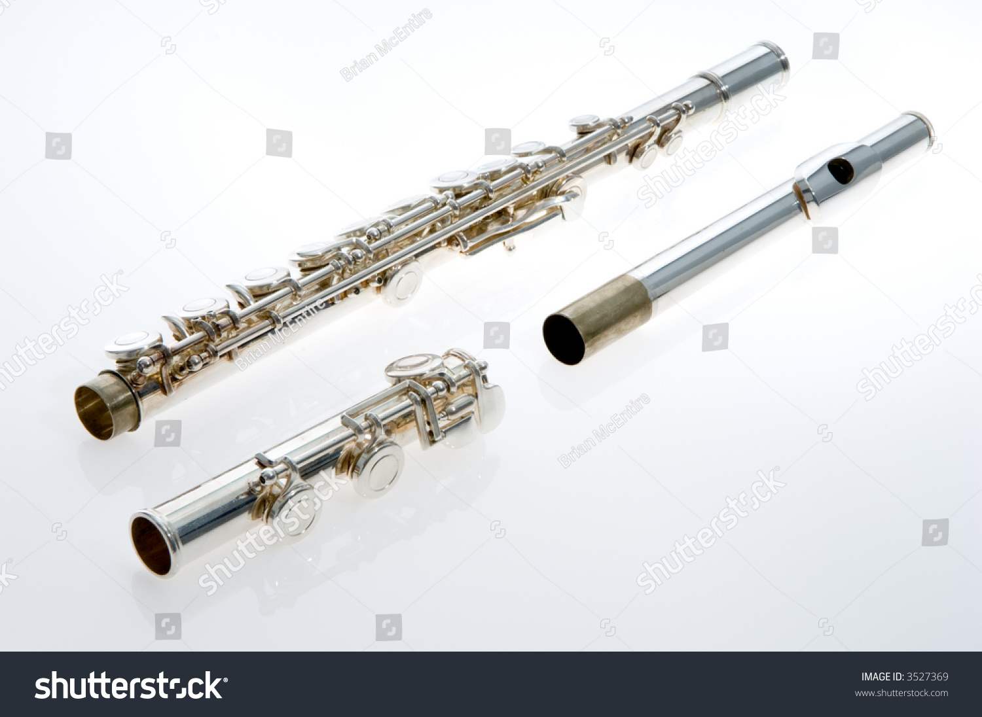
9. Flute Disassembly
McEntire, Brian “Silver Flute Instrument Dissembled Into Three.” Shutterstock. https://www.shutterstock.com/image-photo/silver-flute-instrument-disassembled-into-three-3527369

