Slide 1

High Hopes
Presented visually by Lloyd Silikovitz

Slide 2
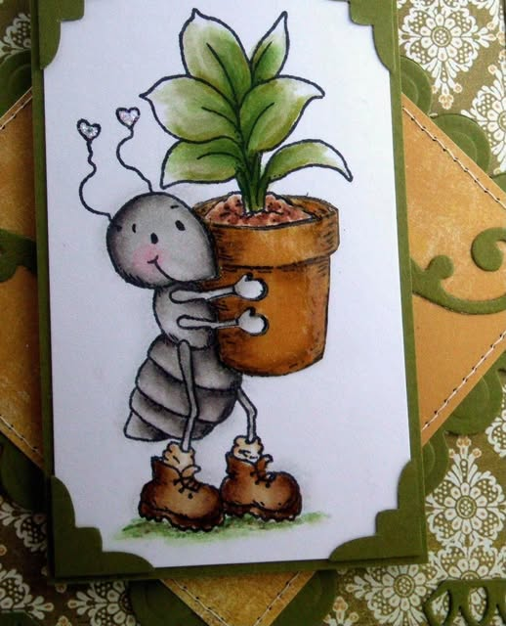
Just what makes that little old ant
Think he'll move that rubber tree plant
Anyone knows an ant can't
Move a rubber tree plant

Slide 3
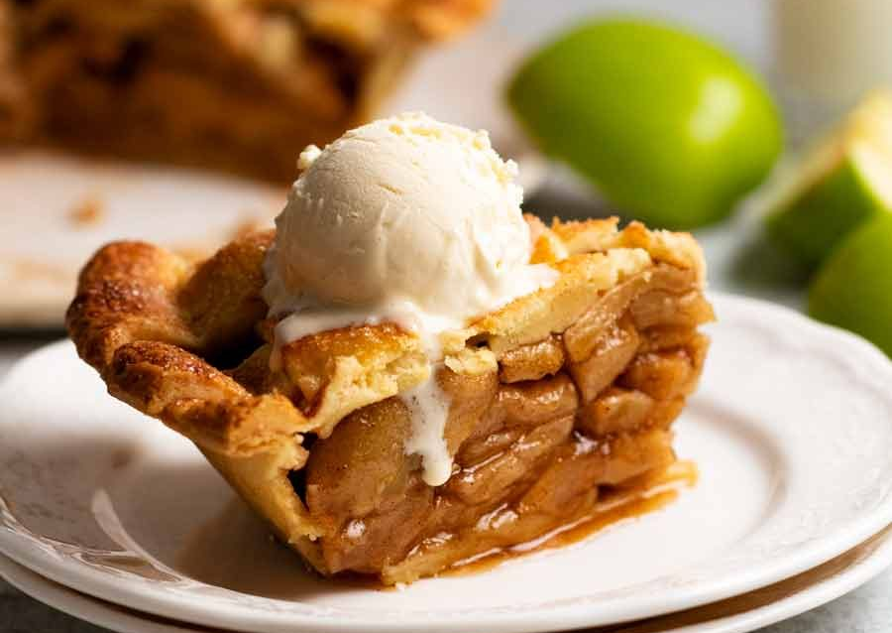
But he's got high hopes
He's got high hopes
He's got high apple pie in the sky hopes

Slide 4
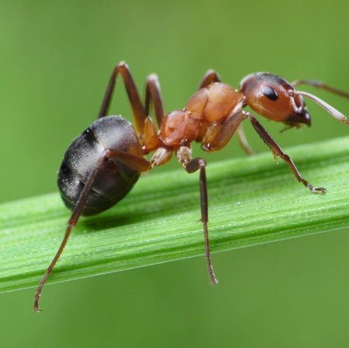
So any time you're gettin' low
'Stead of lettin' go
Just remember that ant:
Oops, there goes another rubber tree plant
Oops, there goes another rubber tree plant

Slide 5

When troubles call
And your back's to the wall
There a lot to be learned:
That wall could fall

Slide 6
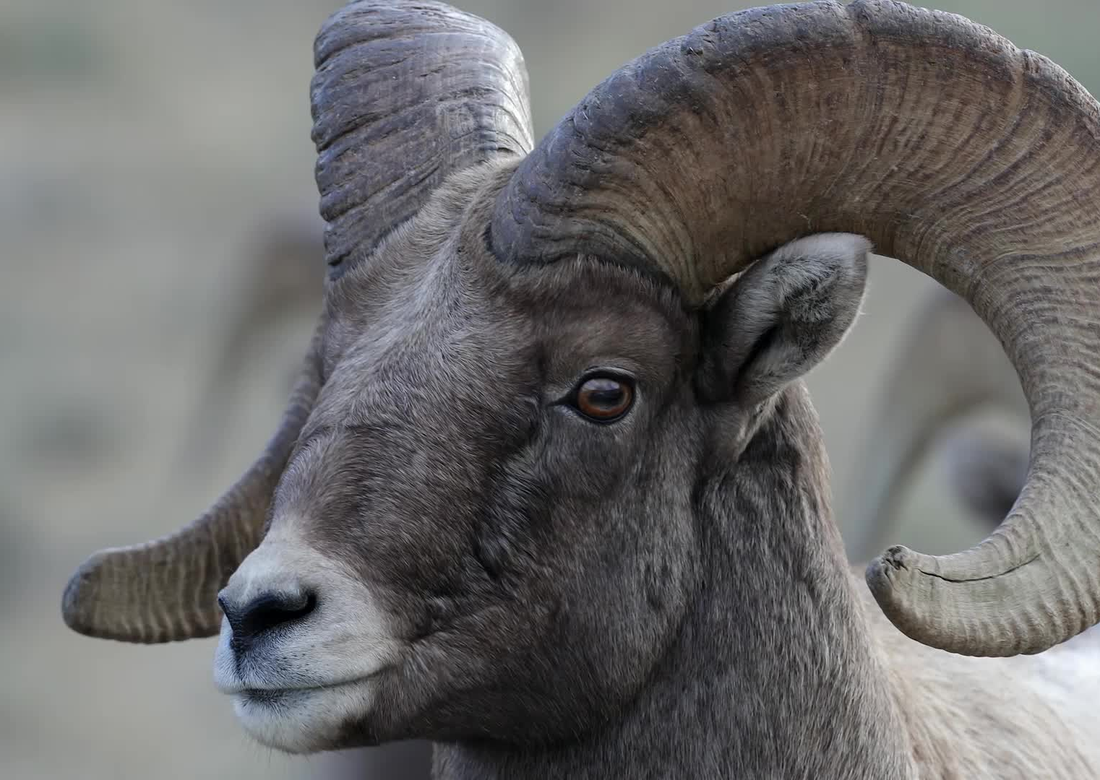
Once there was a silly old ram
Thought he'd punch a hole in a dam
No one could make that ram scram;
He kept buttin' that dam

